Slide 1

Point data case study: geostatistical modelling
A/Prof Benn Sartorius
Email: b.sartorius@uq.edu.au
A/Prof and Principal Research Fellow
ODeSI HERA program, UQCCR
Honorary Visiting Fellow – Centre for Tropical Medicine and Global Health, University of Oxford
Affiliate Professor – Department of Health Metric Sciences, University of Washington

Slide 2

Acknowledgement of Country
The University of Queensland (UQ) acknowledges the Traditional Owners and their custodianship of the lands on which we meet.
We pay our respects to their Ancestors and their descendants, who continue cultural and spiritual connections to Country.
We recognise their valuable contributions to Australian and global society.
Image: Digital reproduction of A guidance through time by Casey Coolwell and Kyra Mancktelow
Notes:
Guidelines for use:
Use this slide when presenting at UQ or at any site in Australia, when appropriate.
Remember to pause briefly after acknowledging Country as a sign of respect.
If you are more familiar with acknowledging Country you may add a statement about the event, meeting or forum’s connection with Country. For example, at a higher education event you might acknowledge that the campus has always been a space for teaching, learning, research and collaboration tens of thousands of years before it was established as a university campus, and this continues today.
When to use longer version:
If you are the main speaker at the event/gathering
If you are the first person to present.
When to use a shorter version:
If you are not the first person to acknowledge Country
In a more informal setting
Thanking a Traditional Owner for welcoming people to Country.
Longer version
I acknowledge the Traditional Owners and their custodianship of the lands on which we meet today. On behalf of *, I pay our respects to their Ancestors and their descendants, who continue cultural and spiritual connections to Country. We recognise their valuable contributions to Australian and global society.
* If you are hosting an event, meeting or seminar, you might say something like, “On behalf of the event organisers or your section….”
Shorter version
I (too,) acknowledge the Traditional Owners and their custodianship of the lands on which we meet today and pay my respect to their Ancestors and their descendants.
You may wish to verbally include a line acknowledging the artwork and artists – “We extend our respect and acknowledge sisters and Quandamooka artists Casey Coolwell and Kyra Mancktelow for A guidance through time, the beautiful and powerful representation of reconciliation at UQ.”
Slide last updated February2023. Source: PVC(IE)/ATSISU (contact Nicole Rawson-Harris: uqrap@uq.edu.au).

Slide 3
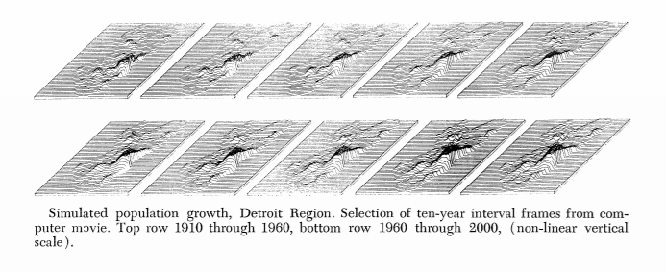

Philosophy of spatial modelling
Tobler’s first law of geography: “everything is related to everything else, but near things are more related than distant things”
W. R. Tobler, A Computer Movie Simulating Urban Growth in the Detroit Region, Economic Geography, 1970, 46, 234-240
Credit: Spatial Analysis of Public Health Data, MSc in Modelling for Global Health, University of Oxford

Slide 4
Spatial Analysis & Modeling Concepts
Account for spatial dependence and more accurately estimate the coefficients of determinants or predictors
Predict values given a set of measured points across an area you can determine the estimated values in unmeasured locations
Using spatial analysis, you can combine information from many independent sources and derive a new set of information by applying a large, rich, and sophisticated set of spatial operators or geo-processing tools

Slide 5
Regression modelling
Ordinary Least Squares (OLS) regression – models and assumptions
Model – simplicity and parsimony
Model – over-determination, multi-collinearity and variance inflation
Typical assumptions
Data are independent random samples from an underlying population
Model is valid and meaningful (in form and statistical)
Errors are iid
Independent; No heteroskedasticity; common distribution
Errors are distributed N(0,σ²)
Credit: Spatial Analysis of Public Health Data, MSc in Modelling for Global Health, University of Oxford

Slide 6
Statistical Reasons for Spatial Modelling
Violation of regression assumptions
Units of analysis might not be independent
Parameter estimates are inefficient
Estimated error variance is downwardly biased, which inflates the observed R² values
If spatial effects are present, and you don’t account for them, your model is not accurate!
Credit: Spatial Analysis of Public Health Data, MSc in Modelling for Global Health, University of Oxford

Slide 7
Advantages of spatial modelling
Spatial modeling offers several advantages over conventional models, particularly when it comes to prediction at unsampled locations and capturing spatial dependencies. Here are some key advantages of spatial modeling:
Incorporation of Spatial Dependencies
Improved Predictions at Unsampled Locations
Enhanced Handling of Spatial Heterogeneity
Uncertainty Quantification
Handling of Irregularly Shaped Areas
Useful to assess scenarios for Spatially Targeted Interventions
Notes:
Incorporation of Spatial Dependencies: Spatial models explicitly account for spatial dependencies or autocorrelation, which is the tendency of nearby locations to have similar values. Conventional models often assume independence among observations, which can lead to biased and inefficient estimates when analyzing spatial data. Spatial models capture these dependencies, resulting in more accurate predictions and better understanding of spatial patterns.
Improved Predictions at Unsampled Locations: Spatial models utilize information from neighboring locations to make predictions at unsampled locations. By considering the spatial relationships between observed and unobserved locations, spatial models can interpolate or extrapolate values more effectively compared to conventional models. This is particularly useful for spatial interpolation, where the goal is to estimate values at locations with no direct measurements.
Enhanced Handling of Spatial Heterogeneity: Spatial modeling is well-suited for capturing spatial heterogeneity, which refers to the variation in data across different locations. Conventional models may struggle to account for such heterogeneity, leading to oversimplified or inaccurate representations of the underlying spatial processes. Spatial models can incorporate spatially-varying effects and explicitly model the spatial variation, resulting in improved predictions and a better understanding of spatial patterns.
Uncertainty Quantification: Spatial models often provide a framework for quantifying uncertainty in predictions and parameter estimates. By incorporating Bayesian methods, posterior distributions can be generated, allowing for the characterization of uncertainty. This is particularly valuable in decision-making and risk assessment, as it provides a range of possible outcomes and their associated probabilities.
Handling of Irregularly Shaped Areas: Traditional models may struggle to handle irregularly shaped areas or complex spatial structures. Spatial models, on the other hand, can accommodate irregular geometries and non-uniform spatial distributions. This flexibility allows for more accurate representation of spatial processes in real-world scenarios.
Spatially Targeted Interventions: Spatial models can inform the design and implementation of spatially targeted interventions or policies. By understanding the spatial patterns and relationships, decision-makers can focus resources and efforts on areas with the greatest need or highest risk. This can be particularly beneficial in areas such as public health, environmental management, and urban planning.

Slide 8
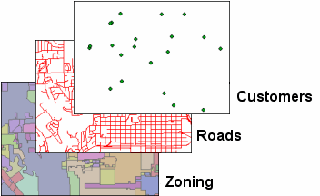
Spatial modelling of point data
Spatially referenced data
POINT PROCESS DATA
CONTINUOUS DATA
Spatial scale of the data
Point (coordinates)
Area or polygon (discrete)
Spatial scale of the data
Point (coordinates)
Point/polyline (discrete)
- Location of all known events
- Limited number of survey sites
“spatial proximity”
“spatial proximity”
DISCRETE DATA
Discrete data can be any of the three geometries: points, polylines, or polygons
e.g. average prevalence per district (aggregated from multiple survey sites)
‘ average’
e.g. number of cases per health centre catchment, or number of births per enumeration area
‘sum / rate’
“spatial neighbourhood”
Credit: Spatial Analysis of Public Health Data, MSc in Modelling for Global Health, University of Oxford
Notes:
The data locations may: be points, regions, line segments, or curves;
be regularly or irregularly spaced; regularly or irregularly shaped;
belong to a Euclidean or non-Euclidean space.

Slide 9
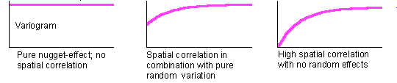
Sampling/empirical variogram
The sample variogram is a spatial decomposition or partition of the sample variance and is an exploratory spatial data analysis
Variogram allows us to investigate the spatial scale at which the phenomenon under study is spatially autocorrelated.
Variogram can be defined as the variance of the difference between field values at two locations
We compare all pairs of points, squaring their differences, but rather than simply taking their mean, we put the pairs into bins according to distance (and angle), and represent each bin by its mean.
A variogram that is "flat" (i.e. the same across bins) tells you that you needn't worry about spatial autocorrelation (at the scale examined)
https://www.nku.edu/~longa/modules/geostats/lec.html

Slide 10
Relationship of the variogram to other measures
The variogram is closely related to other, similar measures of spatial autocorrelation (e.g. Moran’s I, Geary’s C, correlogram).
"Local spatial statistics: an overview", by A. Getis and J. K. Ord (pp. 261-277 in Spatial Analysis: Modelling in a GIS Environment, Longley, P. and M. Batty, eds.
We can consider both the correlogram and the variogram as global, multiple distance measures of spatial autocorrelation, whereas Moran's I and Geary's C are the corresponding global, single distance measures.
https://www.nku.edu/~longa/modules/geostats/lec.html

Slide 11
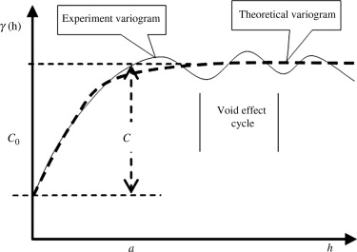
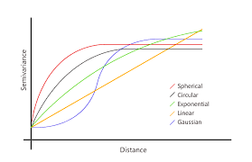
Variogram model (theoretical)
Variogram is the key function in geostatistics = used to fit a model of the spatial correlation of the observed phenomenon.
Generally, an empirical variogram is used for measured data, because sample information is not available for every location.
The empirical variogram cannot be computed at every lag distance ℎ and due to variation in the estimation it is not ensured that it is a valid variogram.
Geostatistical methods such as kriging need valid (semi)variograms. In applied geostatistics the empirical variograms are thus often approximated by model function ensuring validity. Some important models are:
Exponential variogram model
Spherical variogram model
Gaussian variogram model
https://www.sciencedirect.com/topics/earth-and-planetary-sciences/variogram
Cressie, N., 1993, Statistics for spatial data, Wiley Interscience.
Chiles, J. P., P. Delfiner, 1999, Geostatistics, Modelling Spatial Uncertainty, Wiley-Interscience.

Slide 12
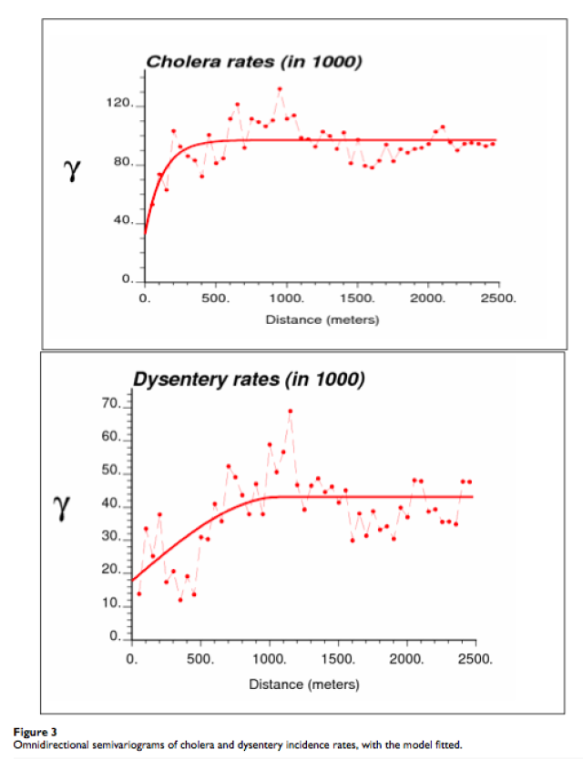
Examples of applied variogram models
Variograms for cholera and dysentery rates in an area of Bangladesh,
In both cases, the rising curve at short distances implies that locations that are closer together are more similar to each other than locations that are farther apart. At a certain point (~300 meters for cholera and ~1000 meters for dysentery), the covariance values reach a plateau, indicating that the difference between rates at locations separated by this distance have reached the value of the overall sample variance.
https://www.publichealth.columbia.edu/research/population-health-methods/kriging-interpolation

Slide 13
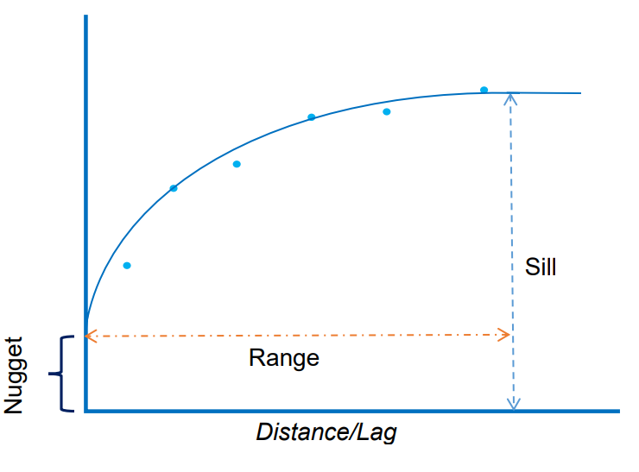
Kriging and variograms
Recap: The variogram displays the (semi)variance, which is a measure of the level of spatial autocorrelation, against distance or lag i.e. measure the strength of statistical correlation as a function of distance
The semi-variogram is the first step towards the mapping of a variable over a whole field or more generally a spatial entity. This mapping process is known as kriging.
Kriging originally developed to estimate attribute values (with probability/uncertainty) from a limited set of sampled data over a continuous spatial region.
Kriging weights come from a semi-variogram that is developed by looking at the spatial structure of the data
Distance at which spatial autocorrelation flattens out is called the range. Areas separated by distances greater than this are not considered to influence each other, whereas areas separated by distances within the range are spatially correlated.
Cramb SM, Duncan EW, White NM, Baade PD, Mengersen KL, 2016. Spatial Modelling Methods. Brisbane: Cancer Council Queensland and Queensland University of Technology (QUT).

Slide 14
Ordinary vs Bayesian kriging
Ordinary least-squares kriging model is one of the most widely used models
However, a common criticism is that its predictions do not take into account the uncertainty in the estimation of the model parameters
i.e. process implicitly assumes that the estimated semivariogram is the truth for the interpolation region.
By not taking the uncertainty of semivariogram estimation into account, ordinary kriging methods often result in variances of the predictions that are too optimistic and these neglected uncertainties in the model parameters can have a significant impact i.e. underestimate the standard errors of prediction
This problem is made worse for smaller datasets
Empirical Bayesian kriging also differs from other kriging methods by accounting for the error introduced by estimating the underlying semivariogram i.e. accounts for error in semivariogram estimation through repeated simulations.
i.e. take into account the uncertainties in the scale and mean parameters of the kriging model

Slide 15
Geostatistical models and Bayesian kriging
Used for point level data
Geostatistical models are used essentially for (at least) three reasons:
to characterize (i.e. model) spatial autocorrelation (via the variogram) and account for spatial dependence in the model,
to create continuous maps based on the data for an area (via kriging), and
to simulate realizations (estimates) based on a given variogram model.
https://www.nku.edu/~longa/modules/geostats/lec.html

Slide 16
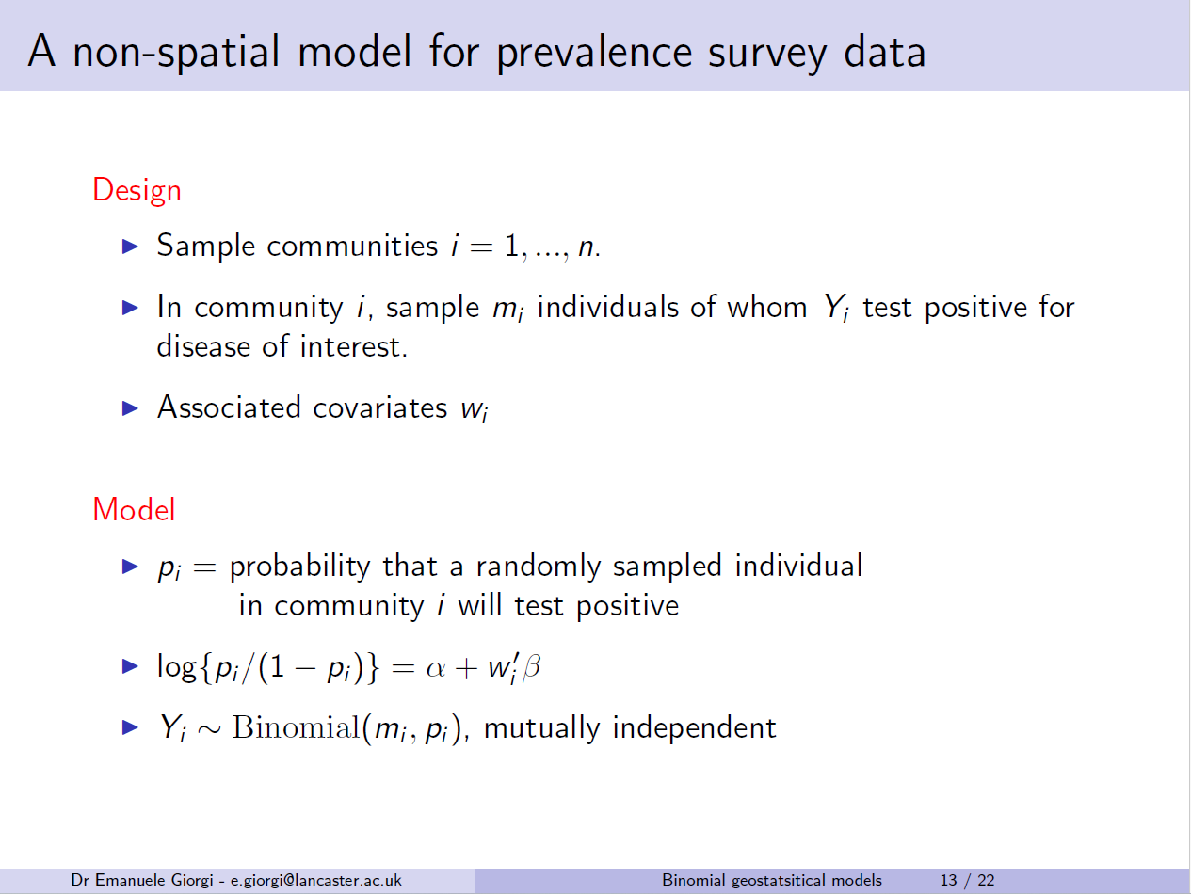

Slide 17
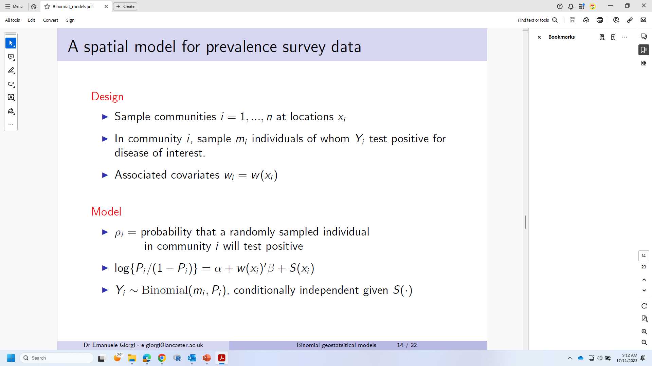

Slide 18
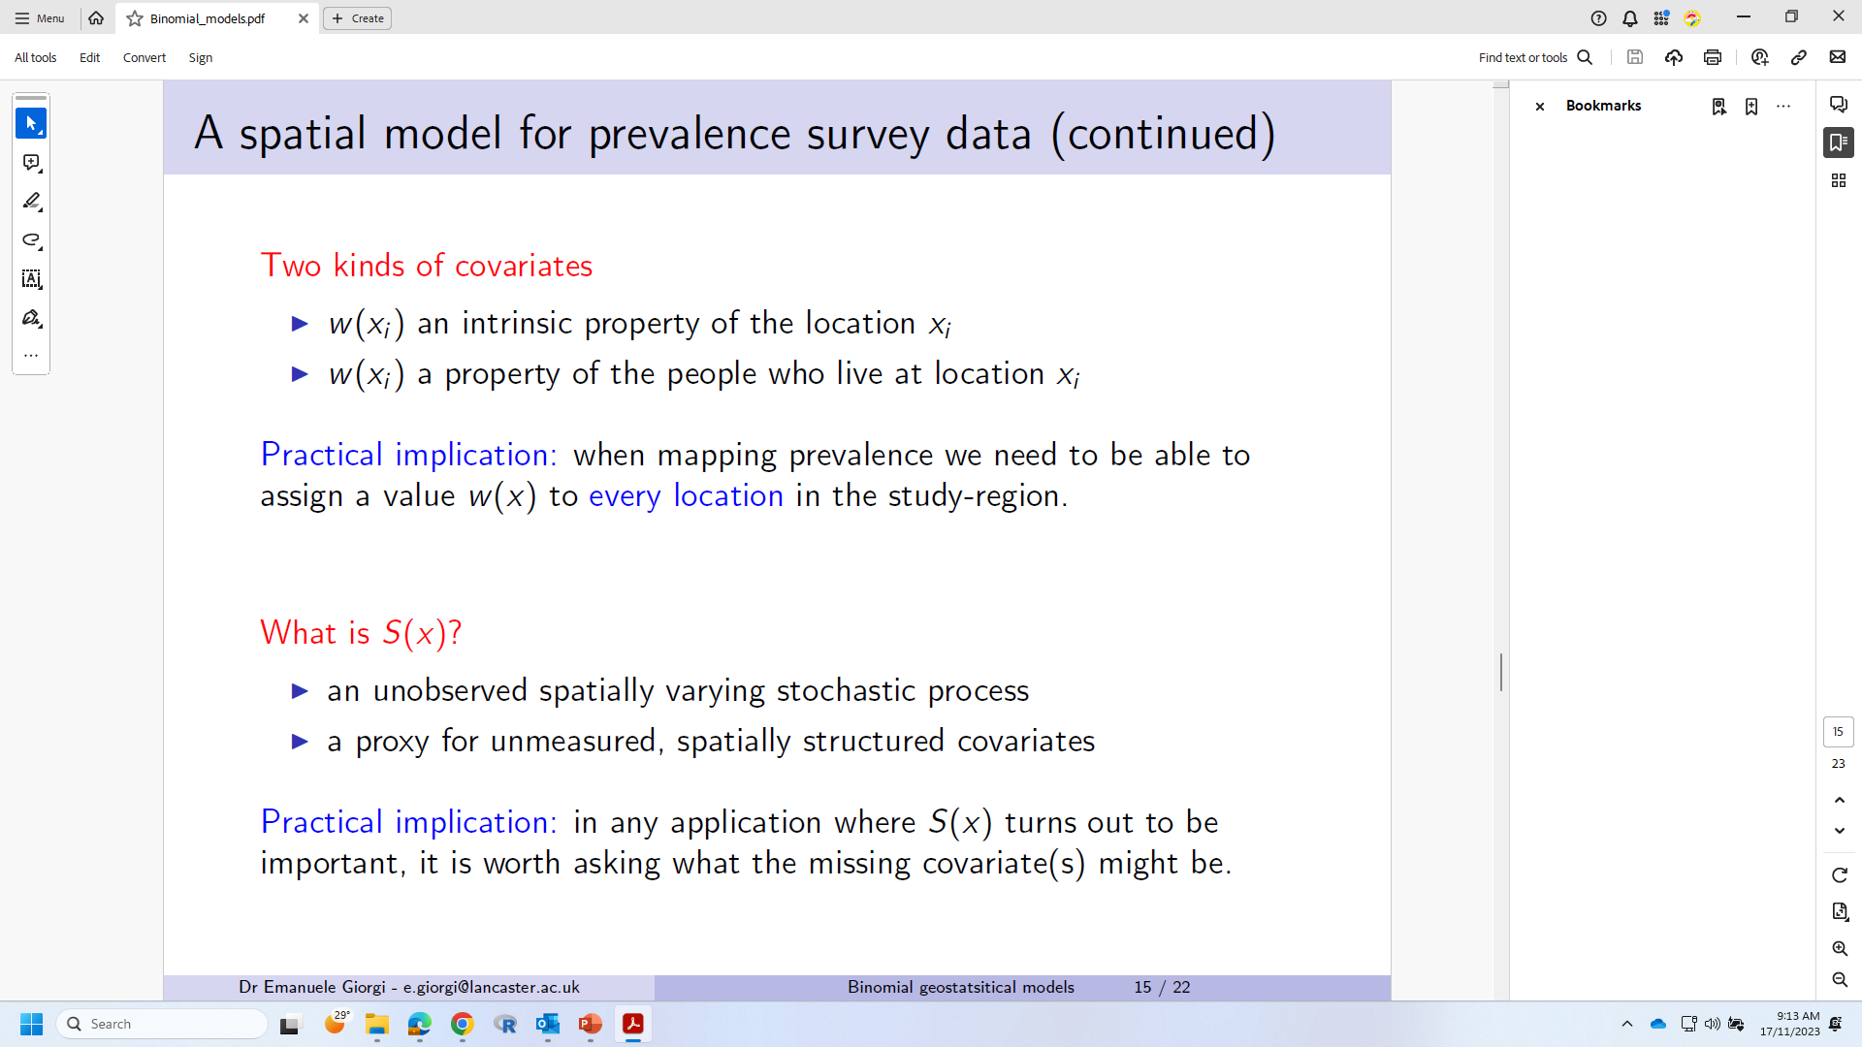

Slide 19
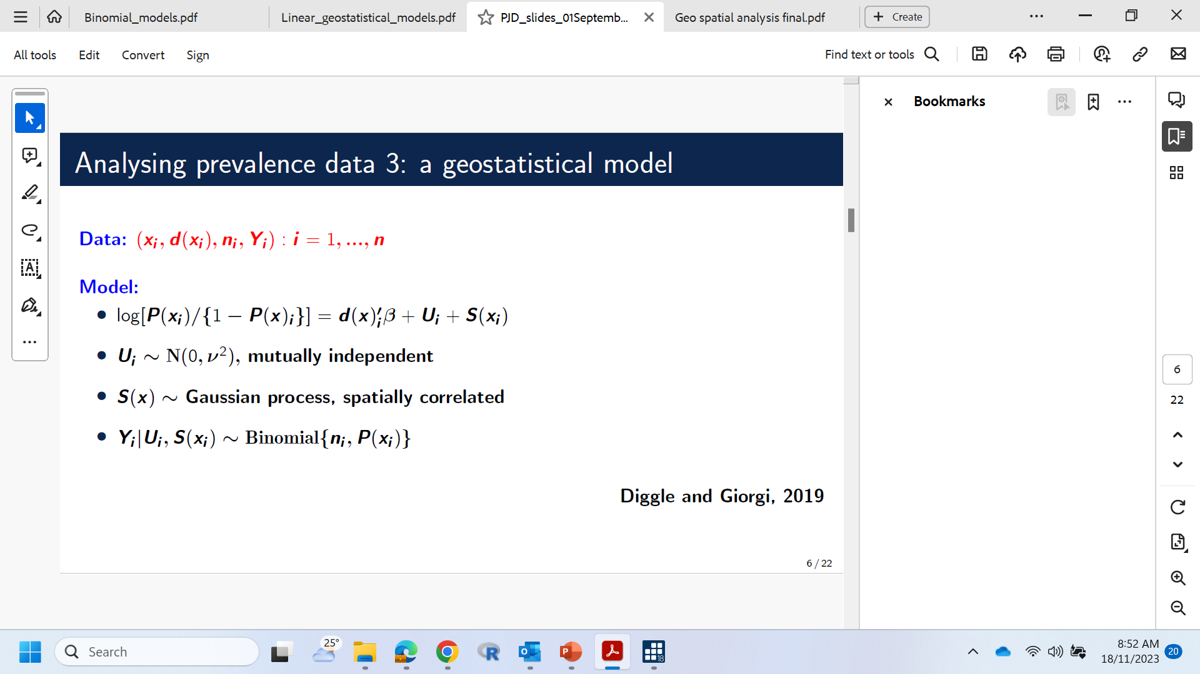

Slide 20
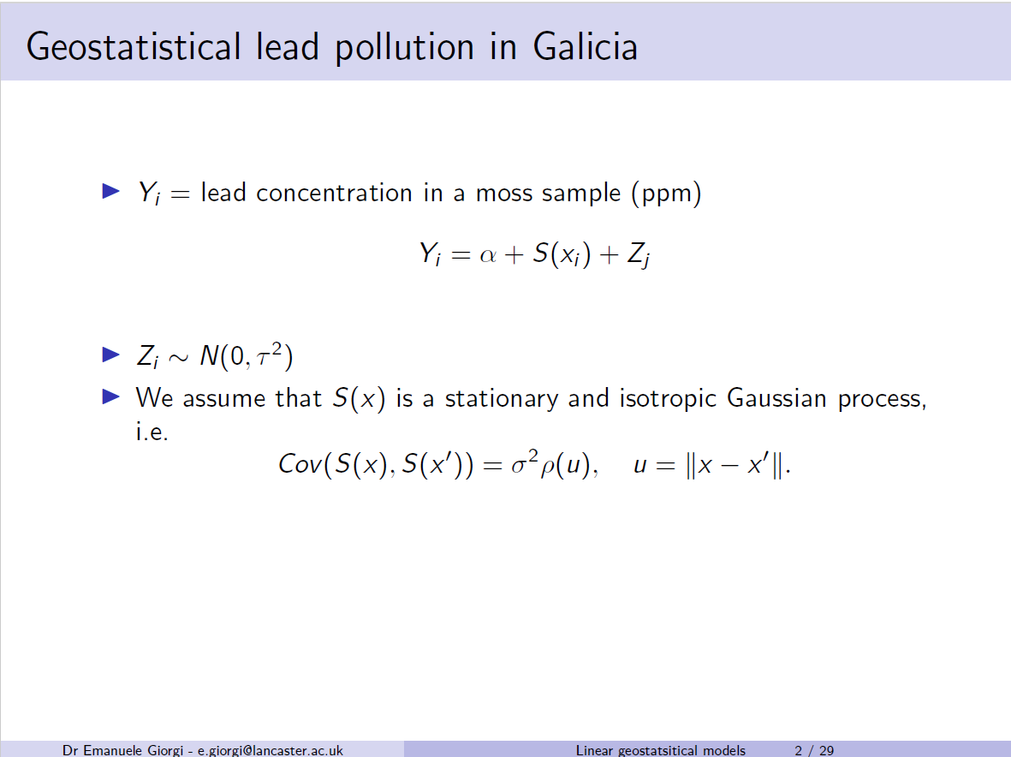
Linear geostatistical models etc

Slide 21
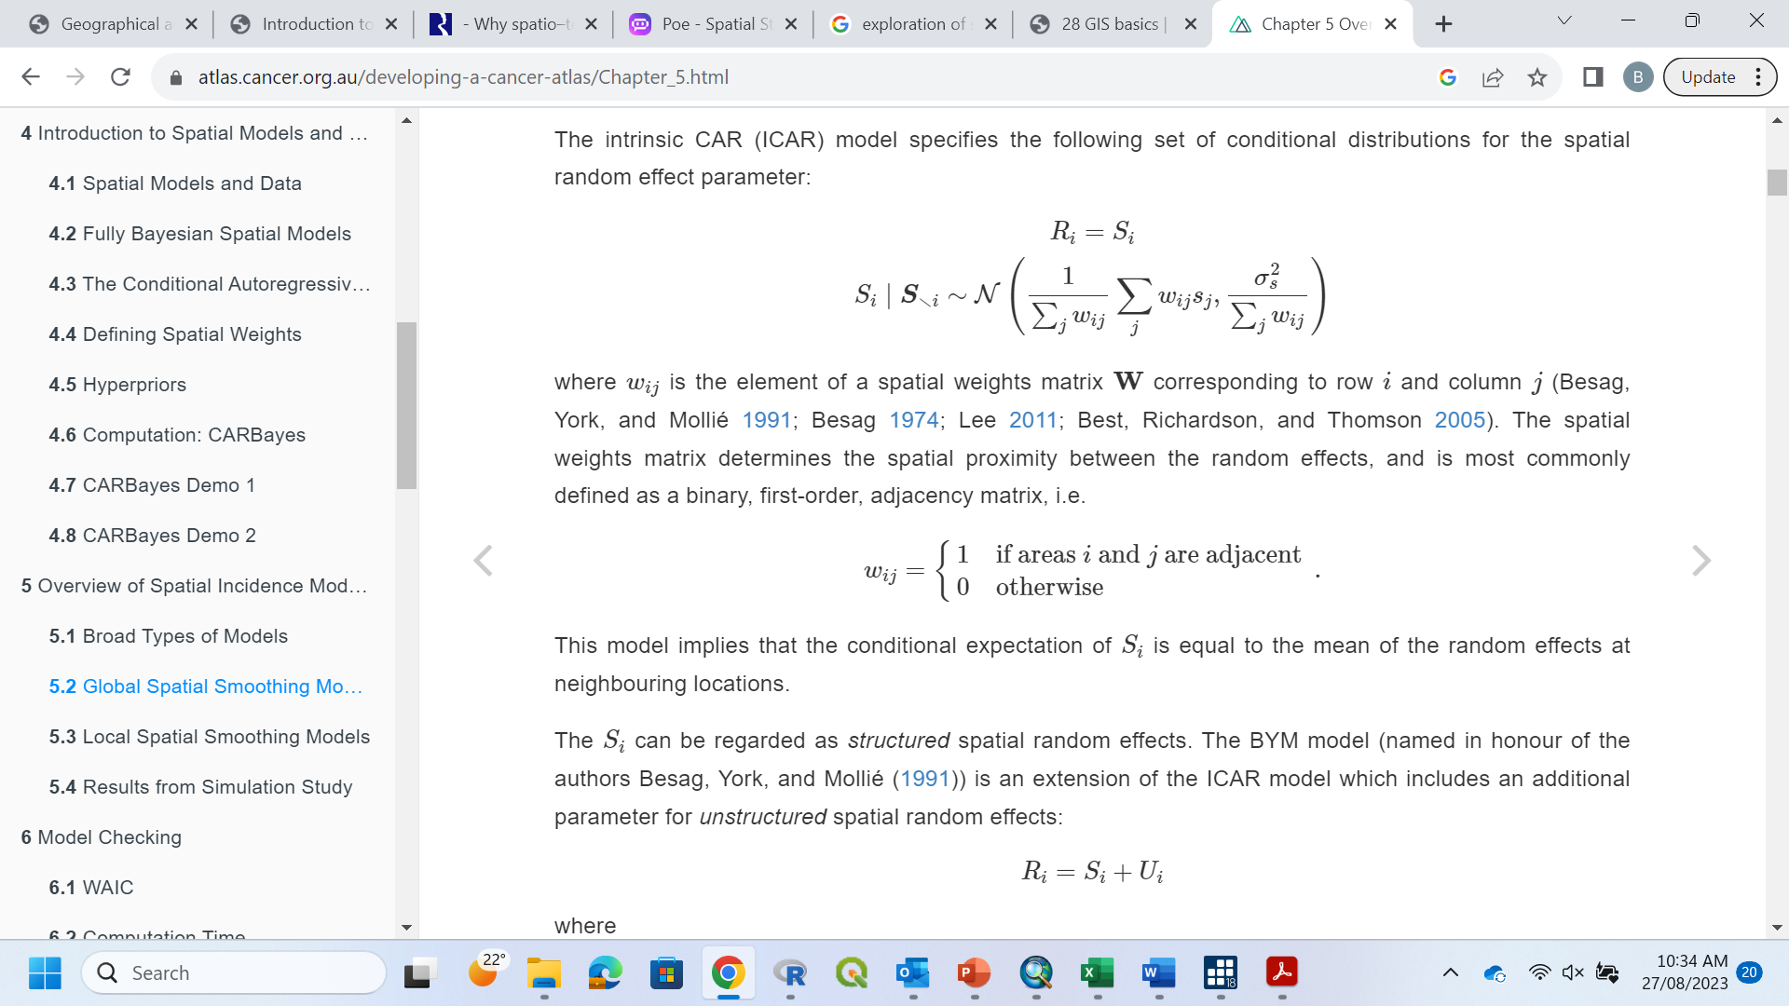
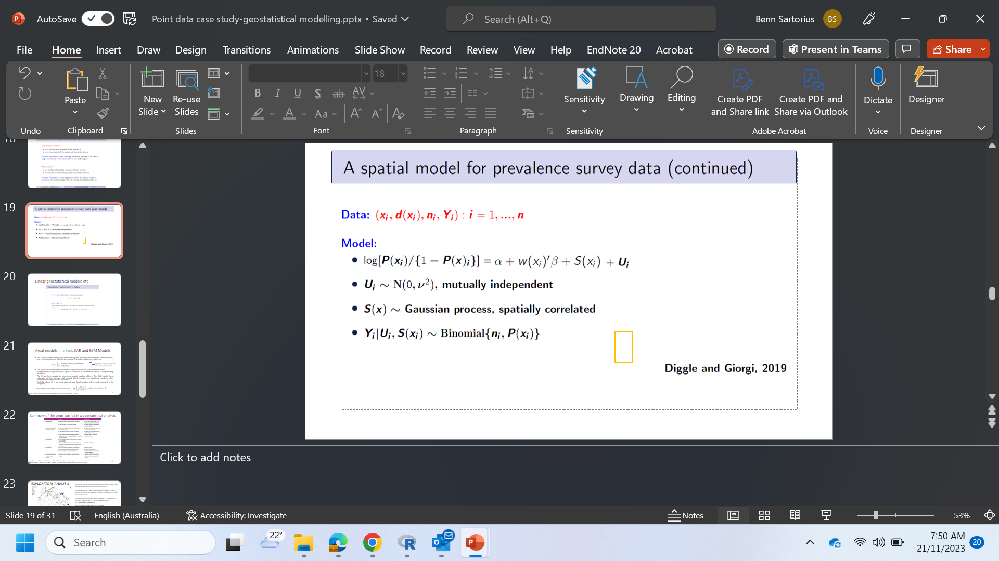
Areal models: conditional autoregressive (CAR)
The spatial weights matrix determines the spatial proximity between the random effects, and is most commonly defined as a binary, first-order, adjacency matrix, i.e.
The model implies that the conditional expectation of the spatial random effect parameter, S(xi), in a given area i is equal to the mean of the random effects at neighbouring locations.
The S(xi) can be regarded as structured spatial random effects. The BYM model is an extension of the intrinsic CAR model which includes an additional random effect parameter for unstructured variation :
Ri=S(xi)+Ui where Ui is an unstructured area level random effect and assumed to be ∼N(0,σ²_{Z}).
Specified in adjacency matrix
shown on previous slide
Recall example from earlier geostatistical model:
https://atlas.cancer.org.au/developing-a-cancer-atlas/Chapter_5.html
Notes:
Build an adjacency matrix of neighbouring areas, then use as a structured spatial random effect (also model an unstructured random effect within each area)

Slide 22
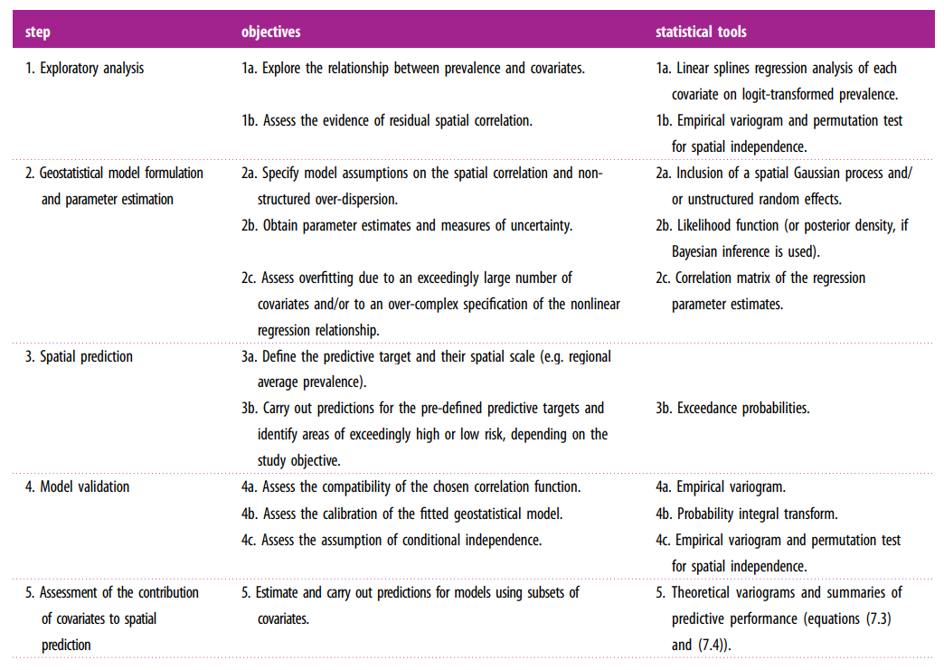
Summary of the steps carried in a geostatistical analysis
Giorgi E, Fronterrè C, Macharia PM, Alegana VA, Snow RW, Diggle PJ. Model building and assessment of the impact of covariates for disease prevalence mapping in low-resource settings: to explain and to predict. Journal of The Royal Society Interface. 2021 Jun 2;18(179):20210104.

Slide 23
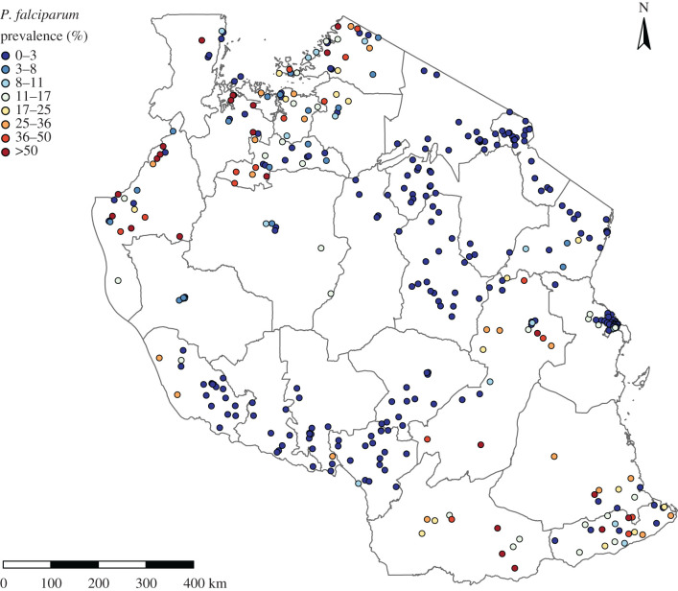
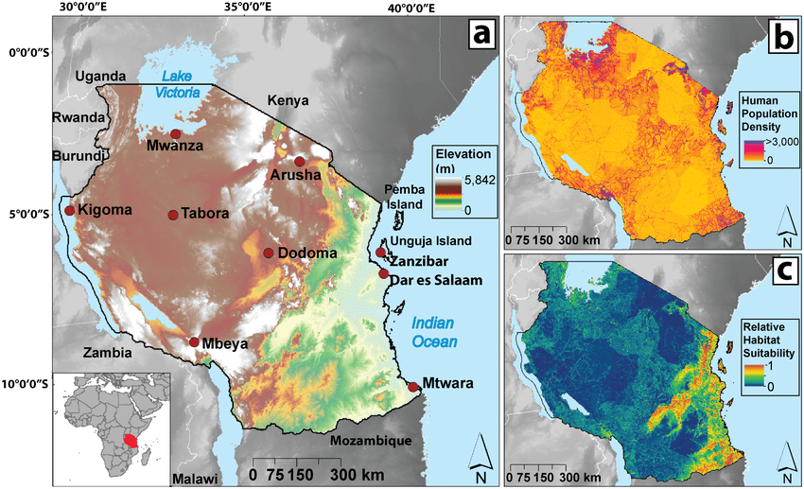
EXPLORATORY ANALYSIS
Data from the Tanzania Demographic and Health Survey and Malaria Indicators Survey conducted in 2015.
Survey employed a two-stage stratified sampling design to provide estimates for the entire country, for urban and rural areas in Tanzania
In all selected households, with the parent’s or guardian’s consent, children age 6–59 months were tested for Plasmodium falciparum.
What is your interpretation of this figure?
Acheson ES, Kerr JT. Nets versus spraying: A spatial modelling approach reveals indoor residual spraying targets Anopheles mosquito habitats better than mosquito nets in Tanzania. PLoS One. 2018 Oct 24;13(10):e0205270.
Figure 1 is a point-map showing the sampled locations of the dataset and their corresponding empirical prevalence.
Giorgi E, Fronterrè C, Macharia PM, Alegana VA, Snow RW, Diggle PJ. Model building and assessment of the impact of covariates for disease prevalence mapping in low-resource settings: to explain and to predict. Journal of The Royal Society Interface. 2021 Jun 2;18(179):20210104.
Notes:
This plot serves two purposes: it visualizes the spatial coverage of the study region; and it gives initial insight into the spatial pattern of prevalence. We observe that the density of the sampled locations corresponds in large part to the distribution of the population in Tanzania, with few or no locations in sparsely populated areas.
In figure 1, we also observe the presence of locations with an empirical prevalence greater than 0.57 in the northwest and in the eastern part of the country. Many locations with no cases reported are found in large swathes of inland Tanzania, especially in the proximity of uninhabited areas.

Slide 24
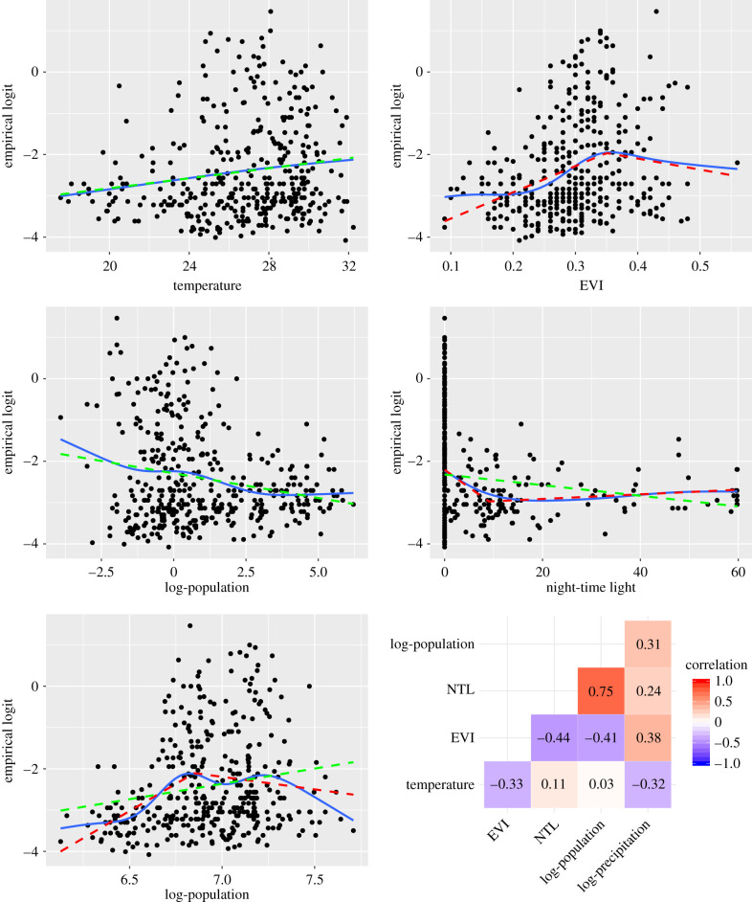
EXPLORATORY ANALYSIS
First we consider the following spatially referenced candidate covariates for modelling P. falciparum, all of which have been used in most previous studies on malaria risk mapping.
Figure presents scatter plots of the empirical logit-transformed prevalence against temperature, enhanced vegetation index (EVI), log-population, night-time light (NTL), log-precipitation and coverage of insecticide treated nets (ITNs).
The solid blue and dashed red lines are natural and linear splines, respectively. The dashed green lines for the log-population and log-precipitation are obtained after removing the left knots from the linear splines represented by the red dashed lines.
The lower right panel shows the empirical correlation between each pair of covariates.
log-precipitation
Giorgi E, Fronterrè C, Macharia PM, Alegana VA, Snow RW, Diggle PJ. Model building and assessment of the impact of covariates for disease prevalence mapping in low-resource settings: to explain and to predict. Journal of The Royal Society Interface. 2021 Jun 2;18(179):20210104.

Slide 25
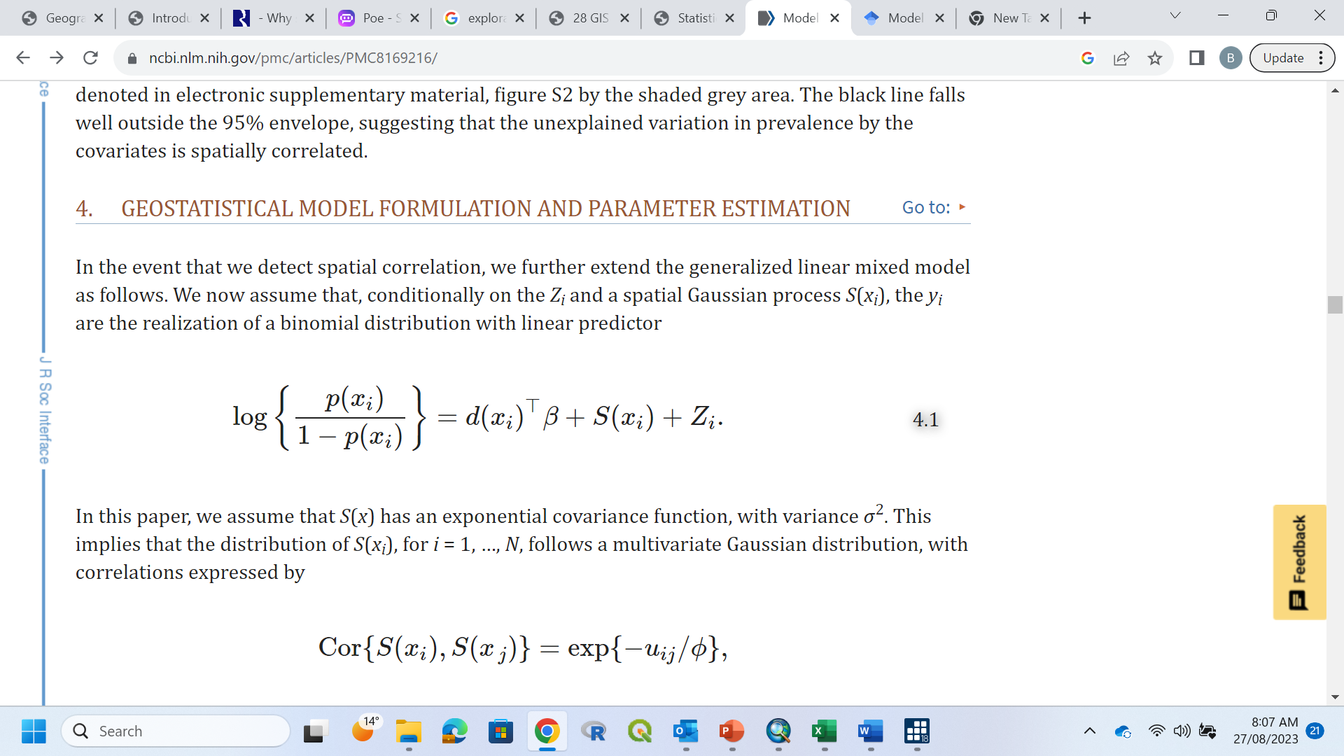
GEOSTATISTICAL MODEL FORMULATION AND PARAMETER ESTIMATION
The research question we address is: in what areas of Tanzania is malaria prevalence above 0.3? As in previous studies, here, we use a 0.3 (i.e. 30%) prevalence threshold to define high malaria burden areas that require intensive and sustained vector control. We can use a spatial model, incorporating influential predictors or determinants, to quantify locations (both sampled and unsampled) with prevalence exceeding this threshold.
In the event that we detect spatial correlation, we further extend the generalized linear mixed model as follows. We now assume that, conditionally on the Z_{i} (unstructured random effect) and a spatial Gaussian process S(x_{i}) (spatially structured random effect) , the y_{i} (P. falciparum positive=1, negative =0) are the realization of a binomial distribution with linear predictor:
We assume that S(x) has an exponential covariance function, with variance σ². This implies that the distribution of S(xi), for i = 1, …, N, follows a multivariate Gaussian distribution, with correlations expressed by
Cor{S(xi),S(x j)}=exp{−uij/ϕ},
where uij is the distance between xi and xj, and ϕ is a scale parameter that regulates how quickly the spatial correlation approaches zero for increasing distance uij. The exponential covariance function corresponds to a mean-square continuous but non-differentiable Gaussian process S(x).
The sum S(x_{i}) + Z_{i} represents all of the variation in prevalence p(x_{i}) that is not attributable to the covariates d(x_{i}).
Giorgi E, Fronterrè C, Macharia PM, Alegana VA, Snow RW, Diggle PJ. Model building and assessment of the impact of covariates for disease prevalence mapping in low-resource settings: to explain and to predict. Journal of The Royal Society Interface. 2021 Jun 2;18(179):20210104.

Slide 26
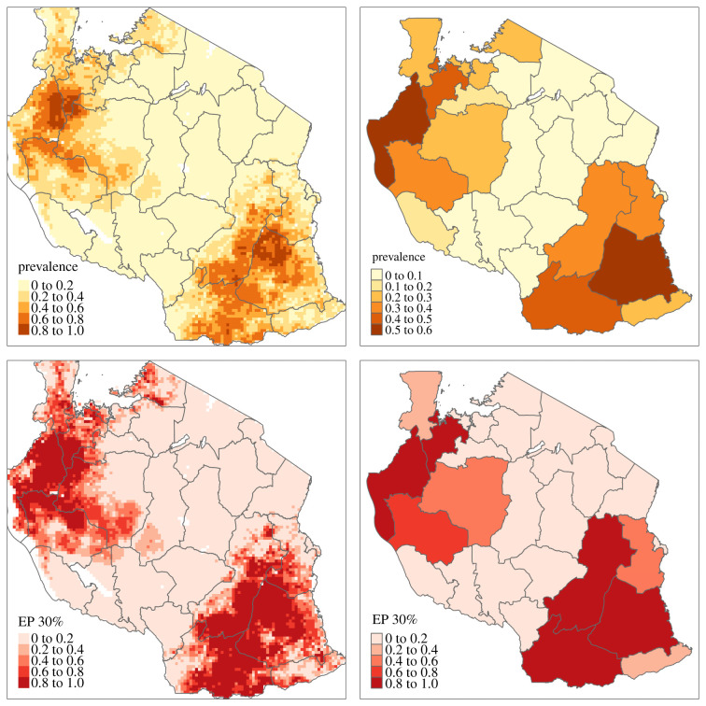
SPATIAL PREDICTION
Maps of the predicted P. falciparum prevalence (upper panel) and of the exceedance probability for a 0.3 prevalence threshold (lower panel) on a 10 by 10 km regular grid. Right panels: maps of the predicted average prevalence, weighted by population density, at regional level (upper panel) and the probability that this exceeds a 0.3 prevalence threshold (lower panel).
Giorgi E, Fronterrè C, Macharia PM, Alegana VA, Snow RW, Diggle PJ. Model building and assessment of the impact of covariates for disease prevalence mapping in low-resource settings: to explain and to predict. Journal of The Royal Society Interface. 2021 Jun 2;18(179):20210104.

Slide 27
MODEL VALIDATION
Validating a geostatistical model involves assessing its performance and evaluating how well it captures the underlying spatial structure and predicts values at unsampled locations.
No single validation method provides a definitive measure of model quality i.e. combination of approaches helps establish confidence in the model's reliability.
Here are some example steps and techniques commonly used for validating geostatistical models:
Splitting the Data (Out-of-Sample Prediction): Divide your dataset into two subsets: a training set and a validation set. The training set is used to build the geostatistical model, while the validation set is used to assess its performance.
Credible interval: compare to see if observed values in withheld data (test) fall within the 95% credible interval from the model prediction
Prediction Error Metrics: Calculate prediction error metrics to evaluate how well the model predicts values at the withheld (test) unsampled locations. Common metrics include mean squared error (MSE), root mean squared error (RMSE), mean absolute error (MAE), or mean error (ME). Lower values indicate better predictive performance.
Residual Analysis: Analyze the residuals, which are the differences between the observed values and the predictions made by the model. Plotting the residuals can help identify patterns or systematic errors in the model. Look for trends, spatial autocorrelation, or heteroscedasticity (varying spread of residuals) to assess the model's adequacy.
External Validation: If available, compare your geostatistical model predictions with independent data or alternative data sources. This external validation can provide further insights into the model's performance and generalizability.
Giorgi E, Fronterrè C, Macharia PM, Alegana VA, Snow RW, Diggle PJ. Model building and assessment of the impact of covariates for disease prevalence mapping in low-resource settings: to explain and to predict. Journal of The Royal Society Interface. 2021 Jun 2;18(179):20210104.

Slide 28
Numerical approaches for Bayesian statistics
Bayesian statistics are highly computationally intensive
Most of the complications that appear in the Bayesian methodology come from the resolution of integrals that appear when applying the learning process: the normalization constant of the posterior distribution, moments and quantiles of the posterior, credible regions, probabilities for the contrasts, etc.
Solutions: Laplace approximations, Quadrature, Monte Carlo methods.
Module 3: Spatial Analysis
David Conesa

Slide 29
Some Useful References
N. Cressie (1990, 1993, 2015). Statistics for Spatial Data (now revised edition).
Banerjee, S., Carlin, B.P. and Gelfand, A.E. (2014) Hierarchical modeling of analysis for spatial data, CRC Press. 2nd edition.
Bivand, R.S., Pebesma, E.J., Gomez-Rubio, V. (2013) Applied Spatial Data Analysis with R, Springer. 2nd Edition.
Lawson, A. (2009) Bayesian disease mapping. Hierarchical modeling in spatial epidemiology, Chapman-Hall.

Slide 30
Tutorial
Giorgi E, Fronterrè C, Macharia PM, Alegana VA, Snow RW, Diggle PJ. Model building and assessment of the impact of covariates for disease prevalence mapping in low-resource settings: to explain and to predict. Journal of The Royal Society Interface. 2021 Jun 2;18(179):20210104.
https://royalsocietypublishing.org/doi/10.1098/rsif.2021.0104
https://github.com/giorgilancs/covariates
Files you need are in the GitHub Tatiana created:
https://github.com/Tatianaproboste/Spatial_Epidemiology/tree/main/04_Point_data_case_study_B_Sartorius

Slide 31
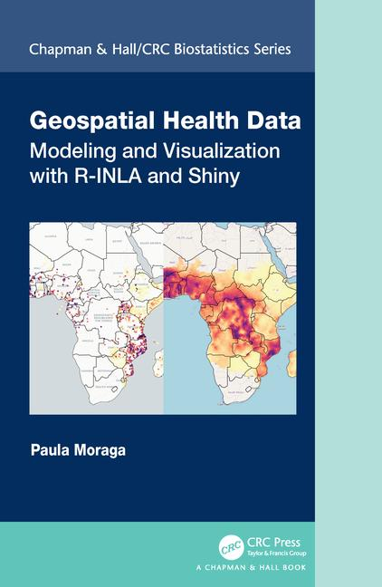
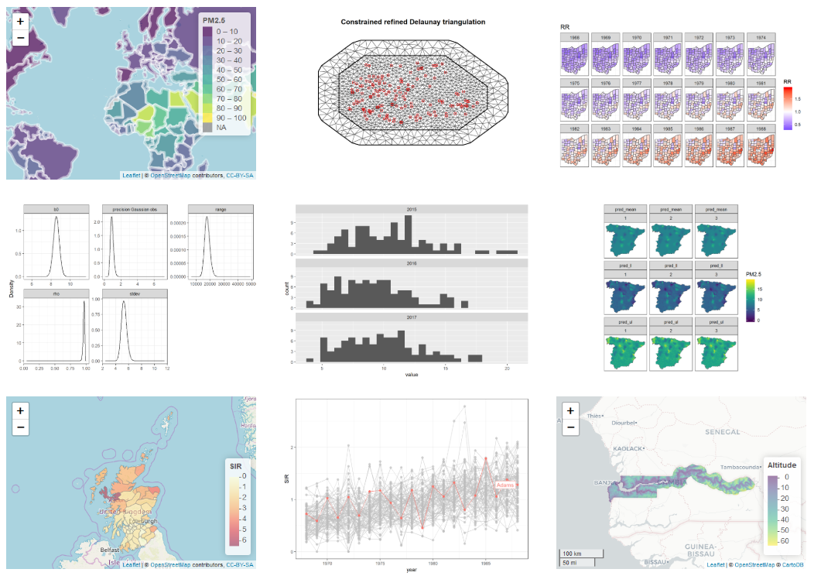
Geospatial Health Data: Modeling and Visualization with R-INLA and Shiny
https://www.paulamoraga.com/book-geospatial/
9 Spatial modeling of geostatistical data. Malaria in The Gambia
https://www.paulamoraga.com/book-geospatial/sec-geostatisticaldataexamplespatial.html

Slide 32
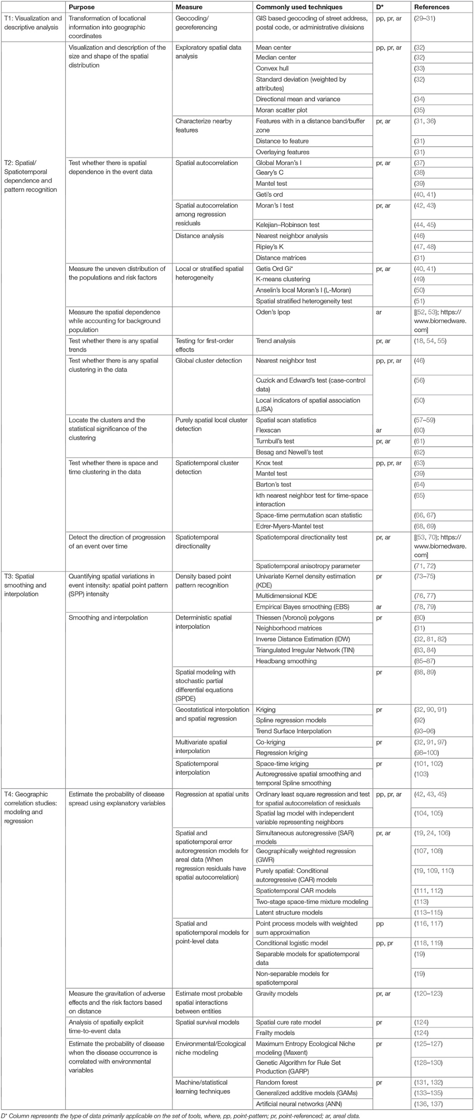
Kanankege KS, Alvarez J, Zhang L, Perez AM. An introductory framework for choosing spatiotemporal analytical tools in population-level eco-epidemiological research. Frontiers in Veterinary Science. 2020 Jul 7;7:339.

